Slide 1

TEAM MEMBERS: AMANDEEP SINGH – 1896409 VARINDER SINGH – 1896305 SANDEEP SINGH SIDHU – 1894980 HARBIR SINGH -1895897 AMANDEEP KAUR – 1794977 PARMINDER KAUR - 1896181
SUBMITTED TO:
PROF. GILLES-PHILLIPPE GREGOIRE
PROF. SAKKARAVARTHI RAMANTHAN
PROF. SAKSHI SHARMA
PROF. HARSHKUMAR DAVE
PROF. SILVIYA PASKALEVA

Slide 2

INTRODUCTION:
Cegep GIM Soccer League is a mobile application which is useful to manage the league. This application is useful to manage teams and players that participate in leagues, create seasons, Schedules and handle scoreboard. However, there are three different types of users which play important role at different places.

Slide 3
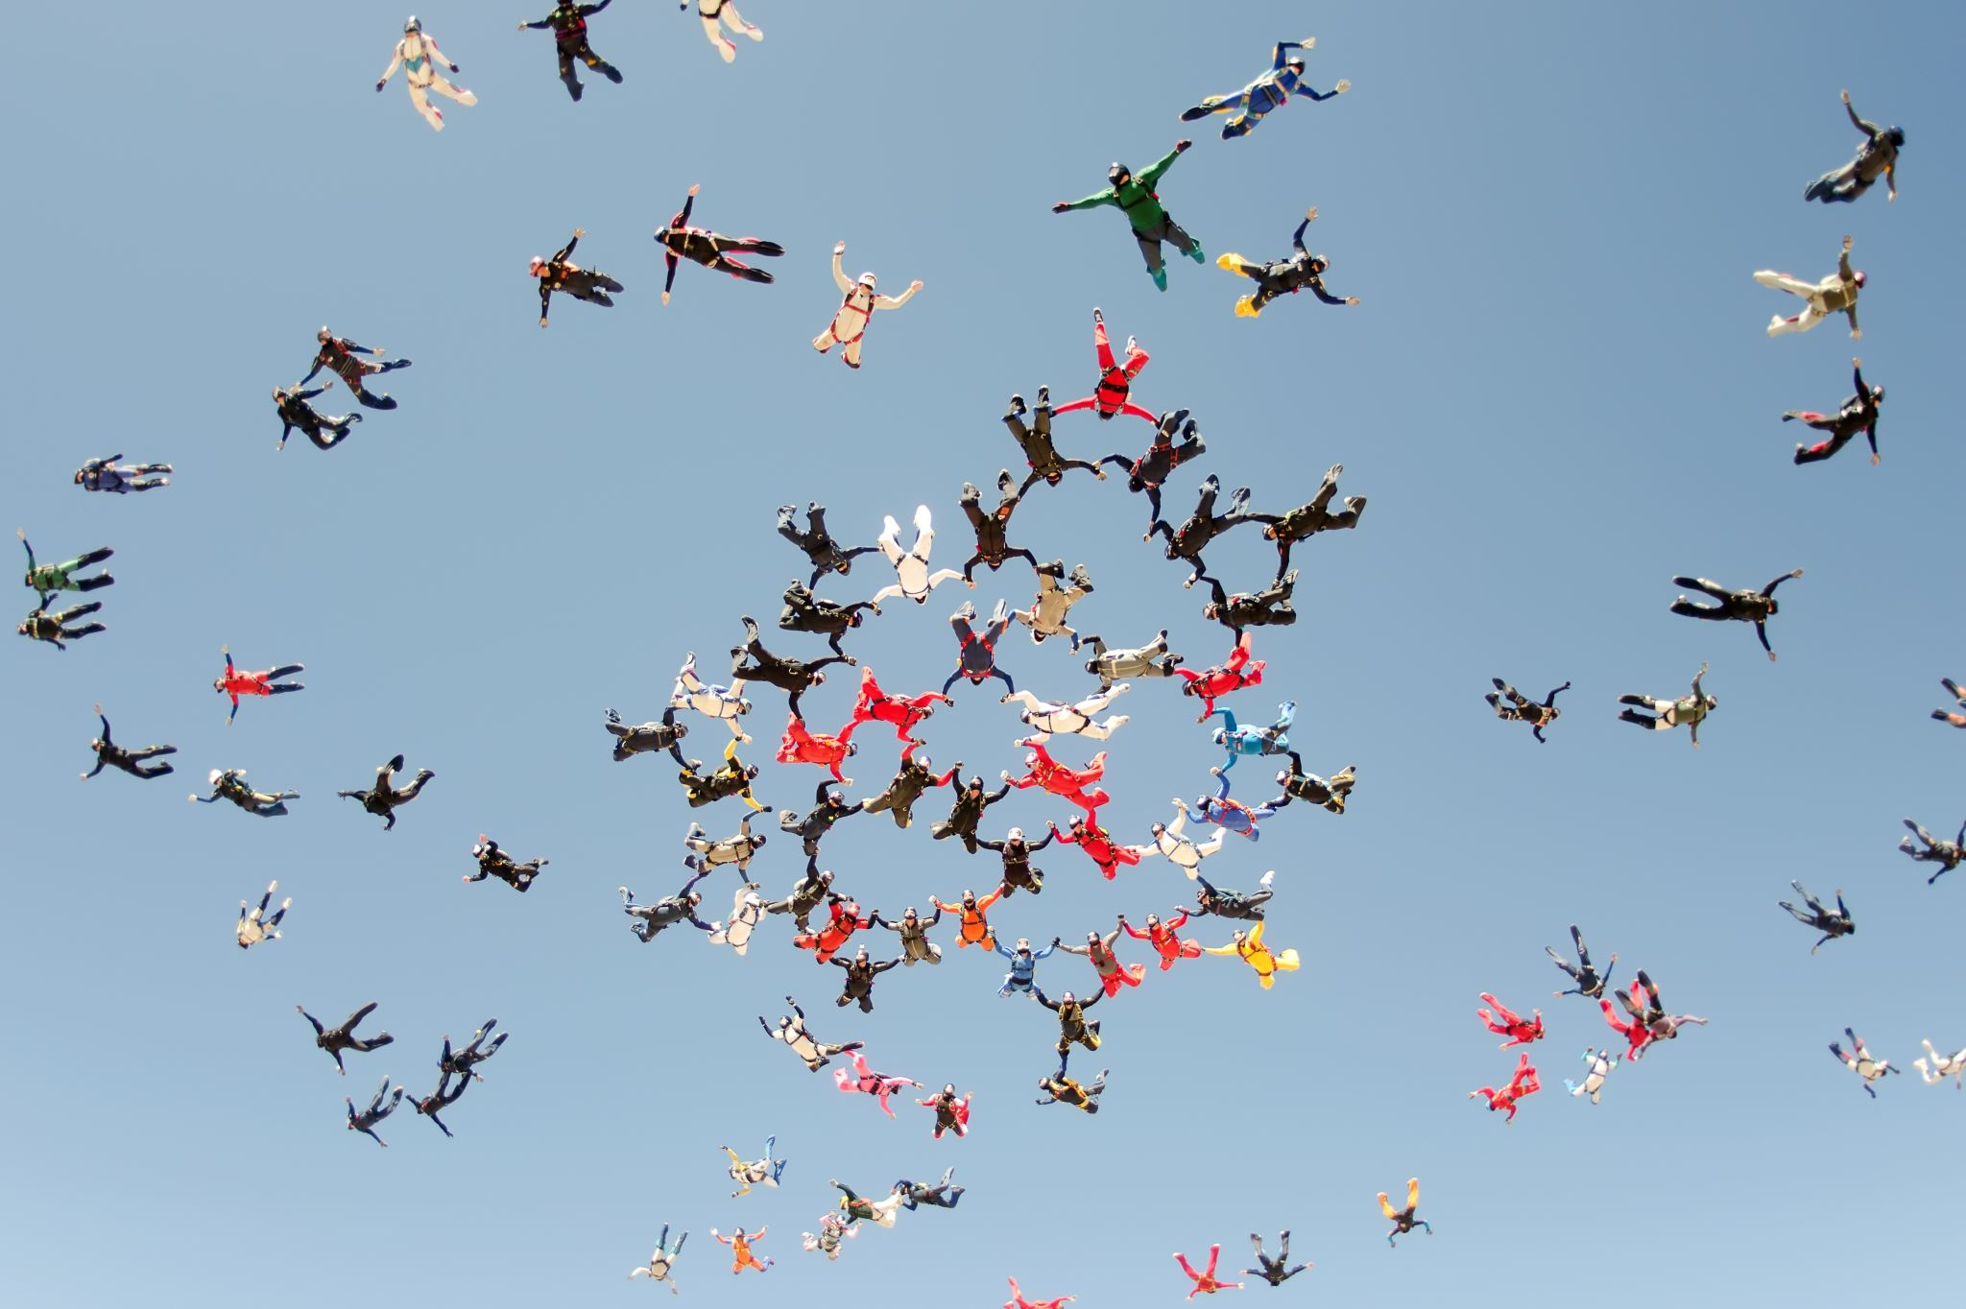
ROLE OF USERS ARE FOLLOWING:-
Guest user:- guest has no authority to login. Guest can view the different features of the application like Scoreboard, Leagues and upcoming matches. Moreover, Guest cannot do any kind of modifications.
League Manager:-League manager has the authority to login. After that League manager can create leagues and Schedules. Even League Manager can enter or modify the results on scoreboard. League manager can access all the teams. Furthermore, League manager has a right to create or delete the teams.
Team manager:-Team Manager has also right to Login as League manager. After Login, Team manger can Edit the Team information, View Players, add Players, update and delete Players.

Slide 4

PURPOSE:
The Purpose of this application is to maintain all the records of leagues, Teams, Team managers, schedules and score records regarding winning or losing and total score of teams by using Scoreboard.

Slide 5
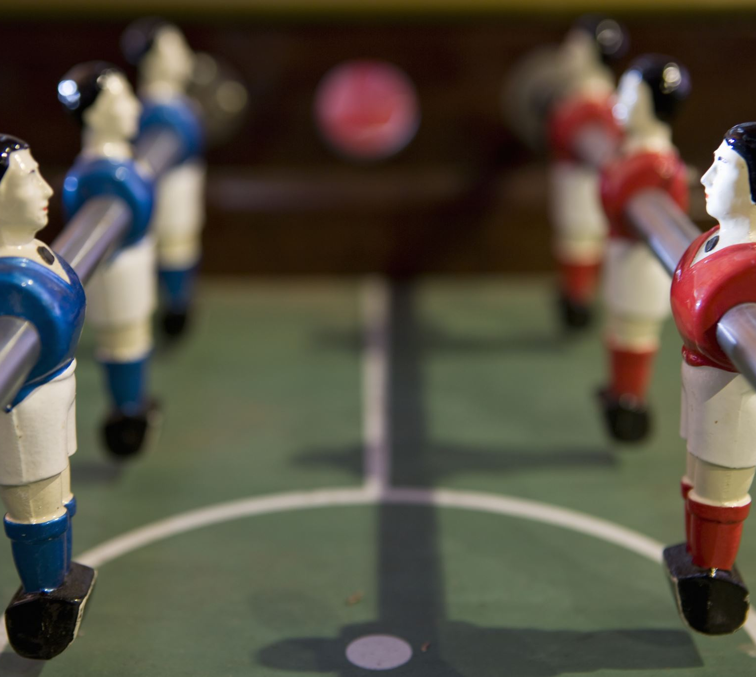
SCOPE:
The Scope of “Cegep GIM Soccer League” is a good for those people and students of the college who are interested in Soccer and who like to watch and play Soccer game . The Gegep GIM Soccer is mobile application which is free to download from a mobile phone application store (Apple Store for iOS - Google Play Store for android).

Slide 6
USE CASE: Use case are the basically the high-level requirement analysis of the system. When the requirements are met functionalities, they are captured in use case diagrams.
USE CASE DIAGRAMS INCLUDES:
Functionalities to be represented as use case.
Actors
Relationships among the use cases and actors.
NOTE : Actors always interact from the outside of the system.

Slide 7
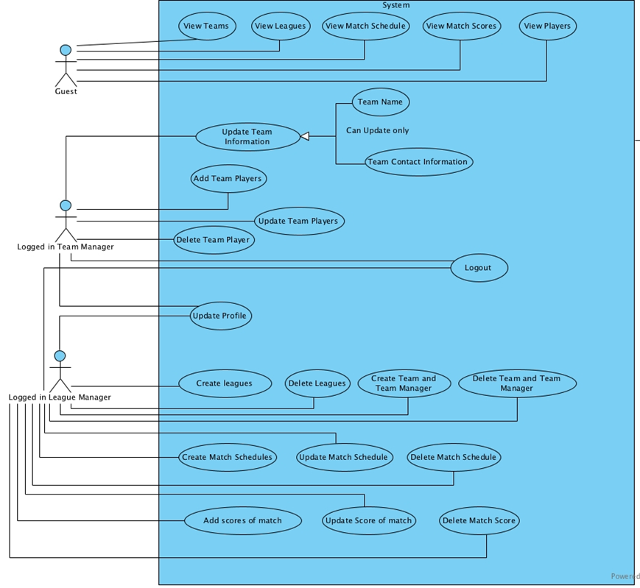
USE CASE DIAGRAM:

Slide 8
FUNCTIONAL REQUIREMENTS:
Sr. No | Name | Description | Must/Could
FR-1 | Login | To use this app, all users must login using user’s Email id and password. It allows user to access al premium feature of application. Team Manager and League manager has over all access of app. | MUST
FR-2 | Sign up | This app must allow user to register them. It requires First Name, Last Name, Email id, Password. | MUST
FR-3 | Forget Password | This app must allow user to reset password incase if user forget. For that user must have to enter registered email and firebase will send a password reset link on registered email via email where user can enter new password. | MUST
This section includes all the requirements that specify all the fundamental actions of the Cegep Gim Soccer League Application.

Slide 9
FR-4 | Guest Users | This app must allow guest user to browse scores, leagues, teams, players and team details but not allowed to modify that details. | MUST
FR-5 | Manage Team Managers | This app must allow only league manager to add or remove team managers. | MUST
FR-6 | Manage Players | This app must allow only team manager to add or remove players with details like player’s first name, player’s last name, player’s age, player’s profile image, and player’s position. | MUST

Slide 10
FR-7 | Manage Seasons (Leagues) | This app must allow only league manager to add or remove seasons (leagues). | MUST
FR-8 | Manage Schedules | This app must allow only league manager to add or update schedules of seasons. For that league’s manager must select team1 and team 2, league, date, time, and place. | MUST
FR-9 | Manage Teams | This app must allow only league manager to add or remove teams. For that league manager must enter team name, team icon, and select team manager for that particular team. | MUST

Slide 11
FR-10 | Modify Team Info | Team manager can edit team info and team squad. | COULD
FR-11 | Manage Score Board | This app must allow only league manager to add or update score board. | MUST

Slide 12
NON-FUNCTIONAL REQUIREMENTS:
Sr. No | Name | Description
NFR-1 | Performance Requirements | The application shall be fast and robust when loading. The application should not take more than 5 seconds to respond.
NFR-2 | Space Requirements | The device shall have enough memory space to load the app.
NFR-3 | Usability Requirements | The application shall be easy to use and understand. The application shall have a user-friendly interface. GUI shall be simple and clear.
NFR-4 | Reliability requirements | The application shall not produce an incorrect output in any manner.
NFR-5 | Implementation Requirements | The application shall be implemented using Android Studio 3.6 and Firebase services.
This section of document specifies how the system should behave and quality characteristics of Cegep Gim Soccer League.

Slide 13
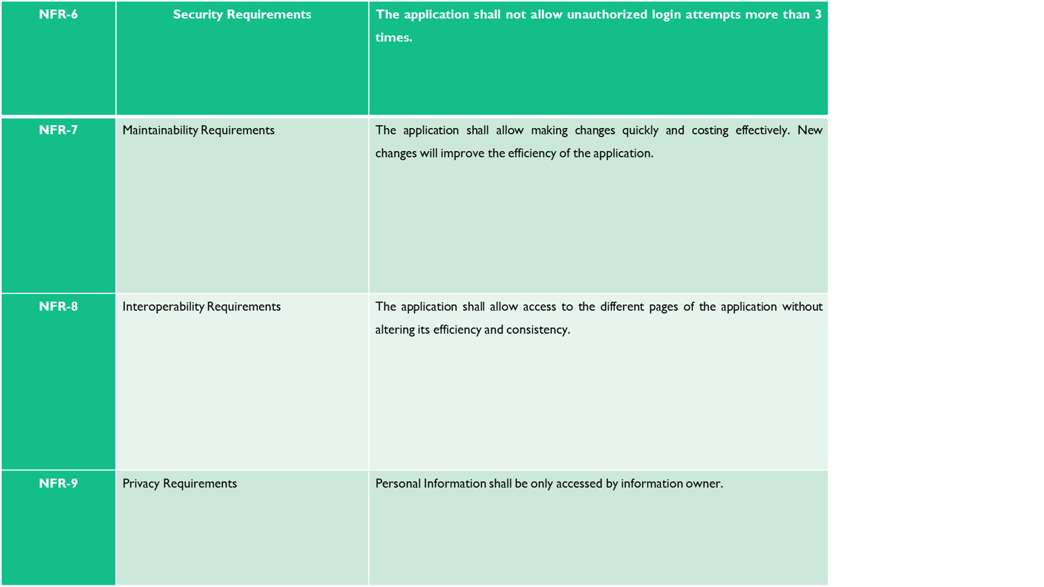

Slide 14
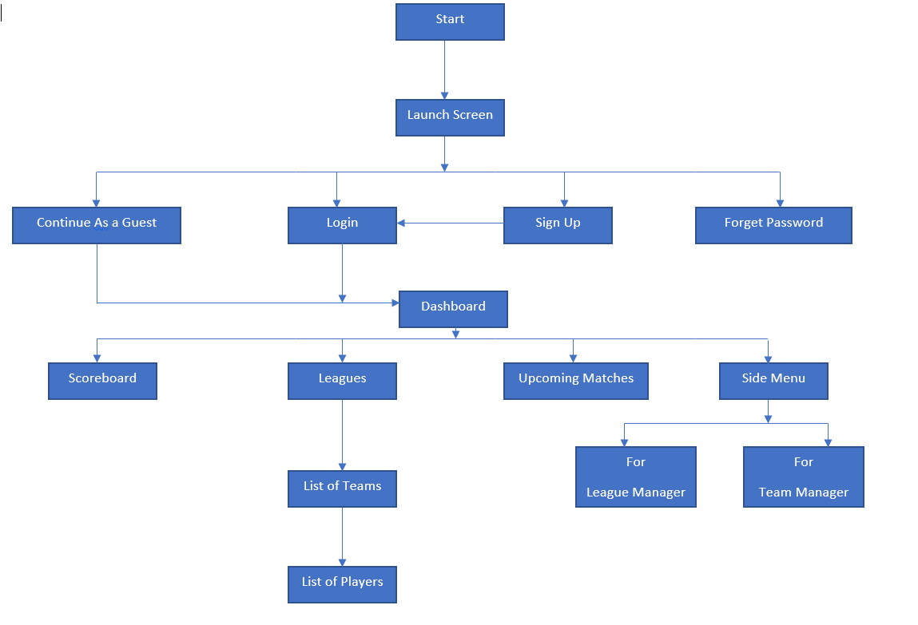
SCREEN FLOW:

Slide 15
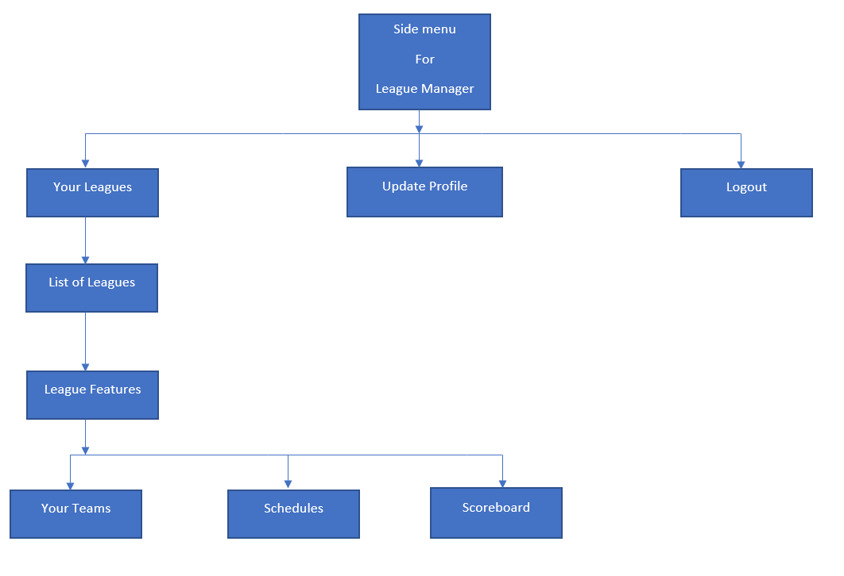
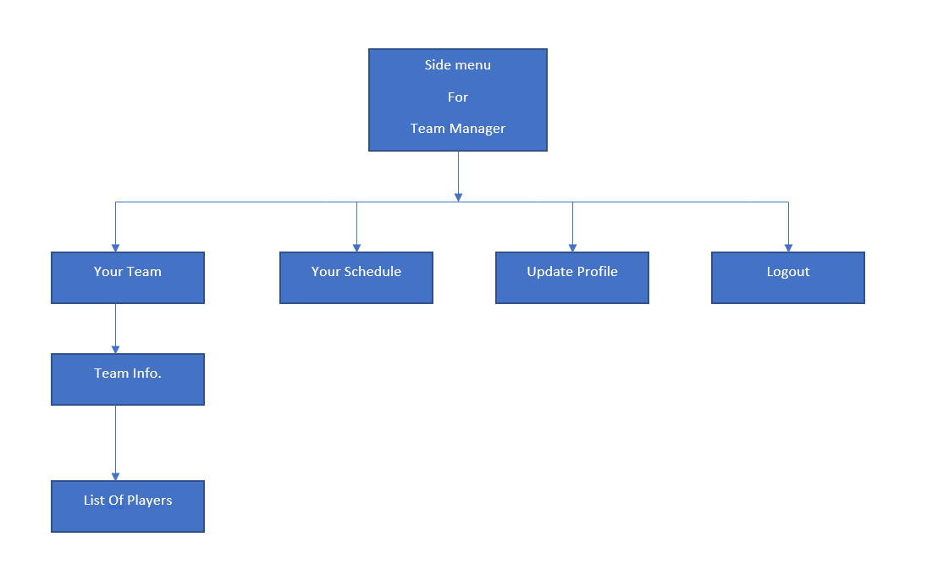
SCREEN FLOW: .League Manager .Team Manager

Slide 16

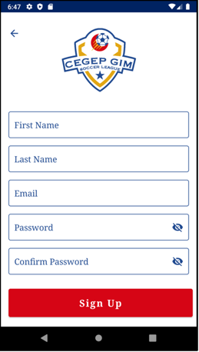
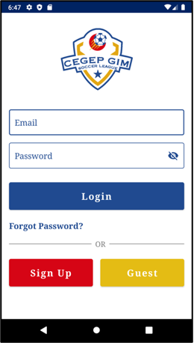
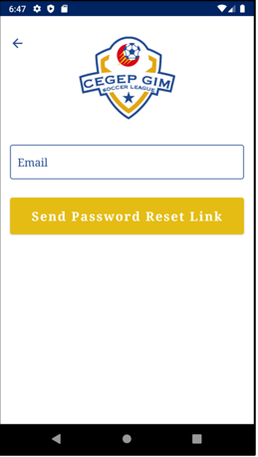
SCREEN DESIGN: Launch screen, sign up, login and forgot password

Slide 17
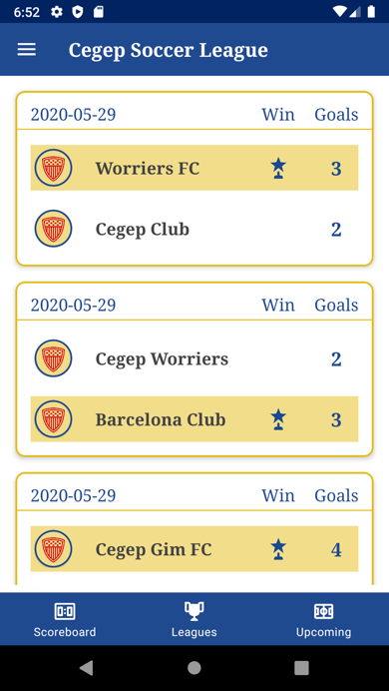
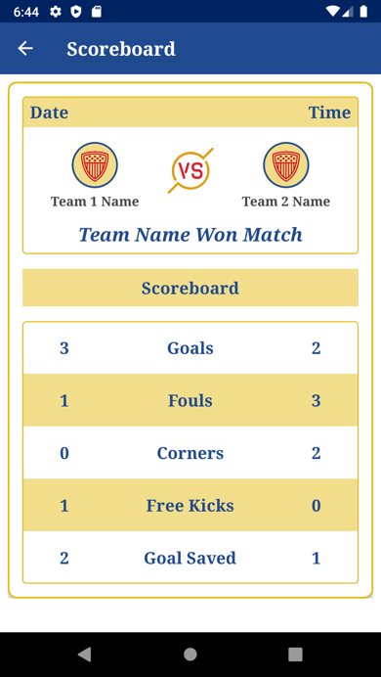
SCOREBOARD TAB SCREEN (ON HOME PAGE)

Slide 18
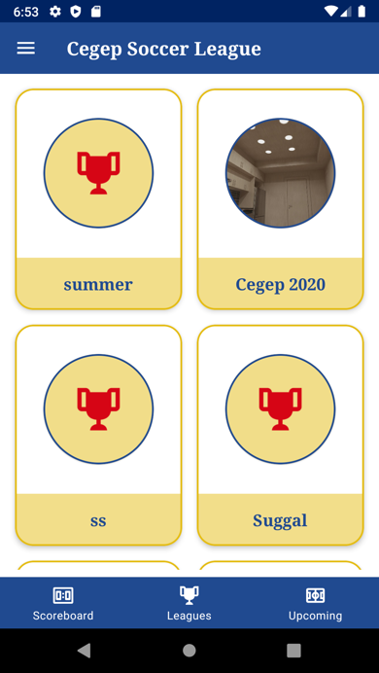
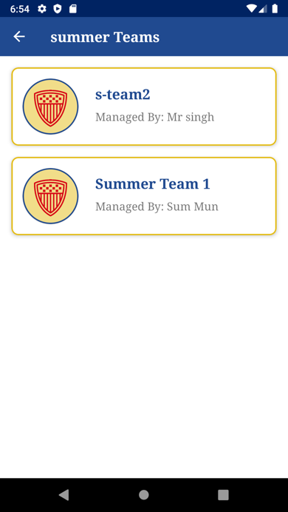
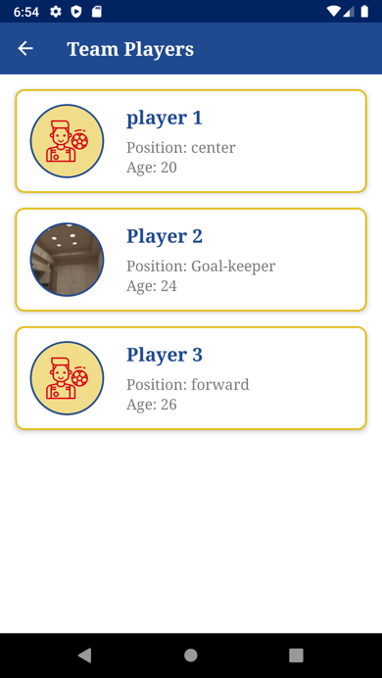
LEAGUES TAB SCREEN (ON HOME PAGE)

Slide 19
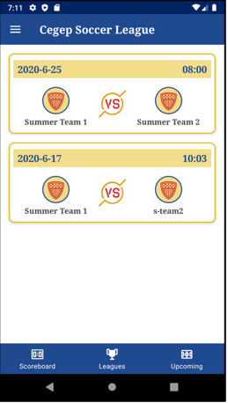
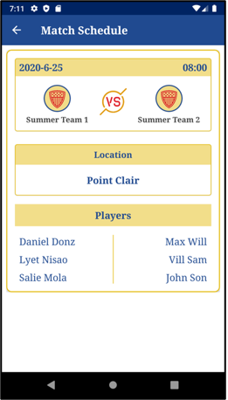
UPCOMING MATCHES TAB SCREEN (ON HOME PAGE)

Slide 20
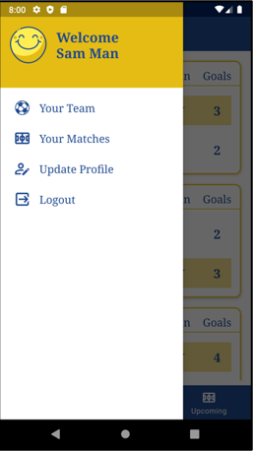
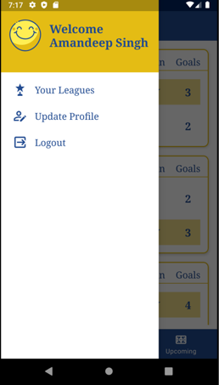
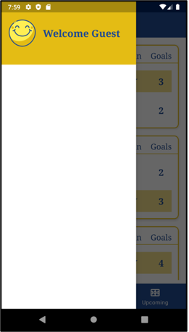
SIDE MENU FOR ALL USERS:
For team manager for league manager for guest users

Slide 21
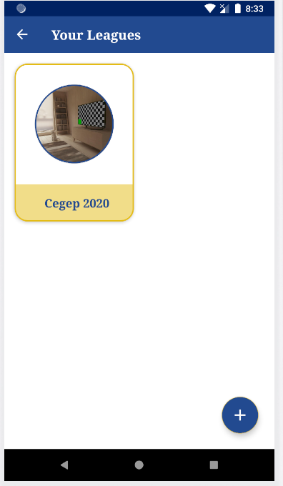
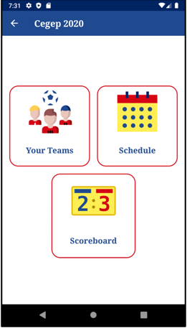
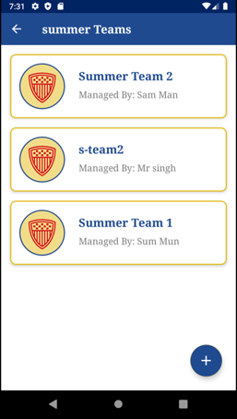
LEAGUE MANAGER FEATURES

Slide 22
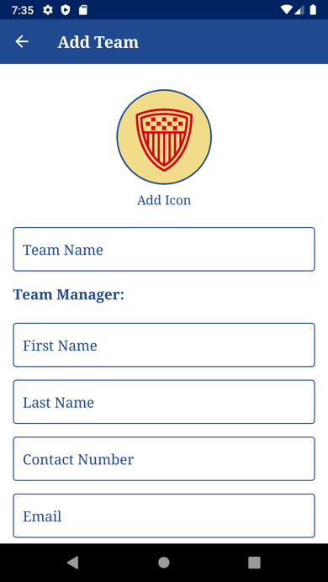
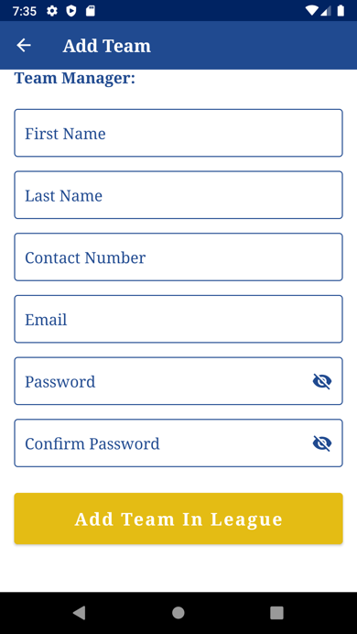
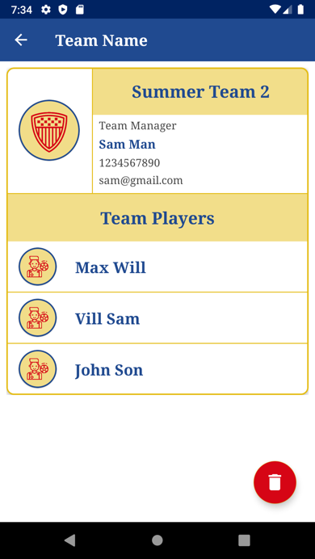

Slide 23
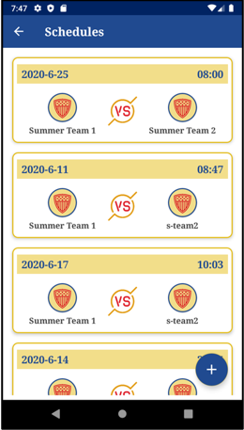
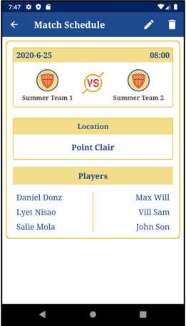
LEAGUE MANAGER SCHEDULE SCREENS

Slide 24
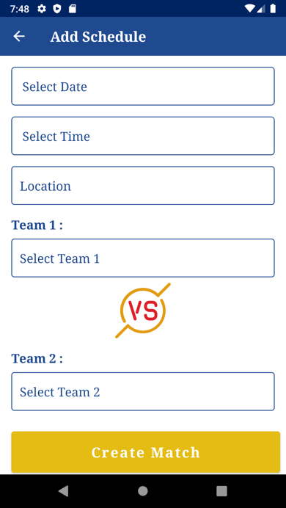
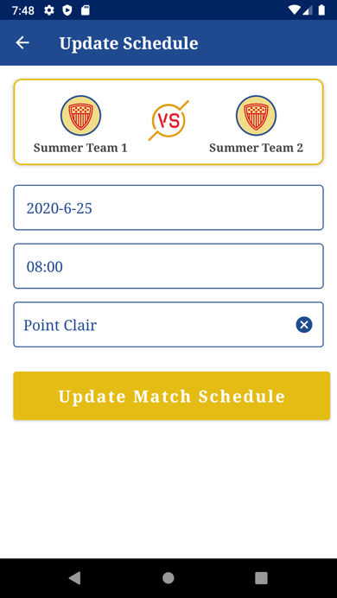
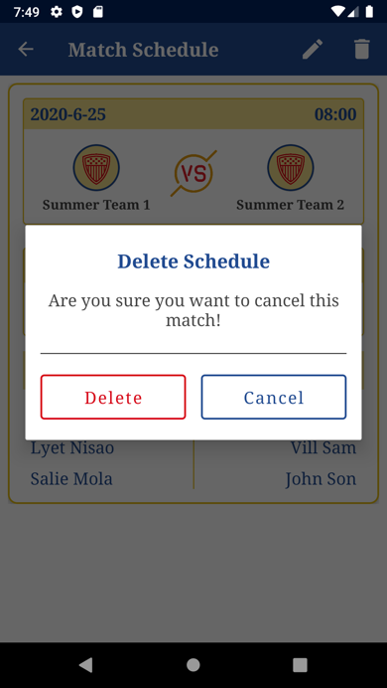

Slide 25
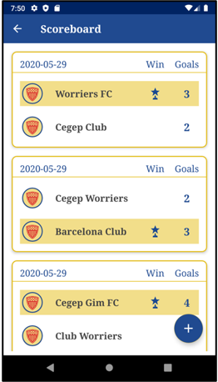
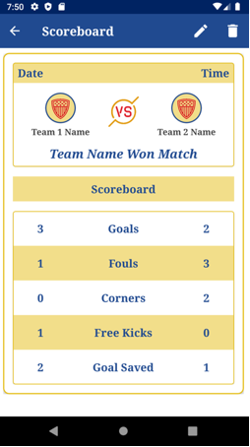
LEAGUE MANAGER SCOREBOARD SCREENS

Slide 26
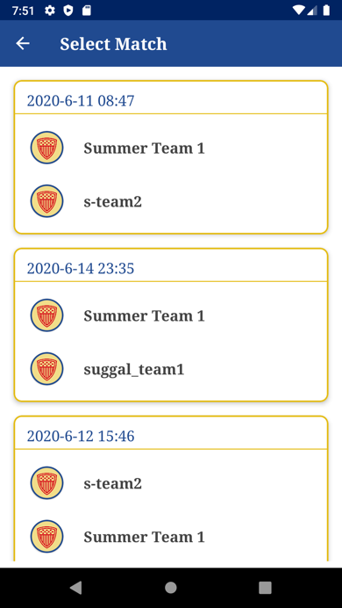
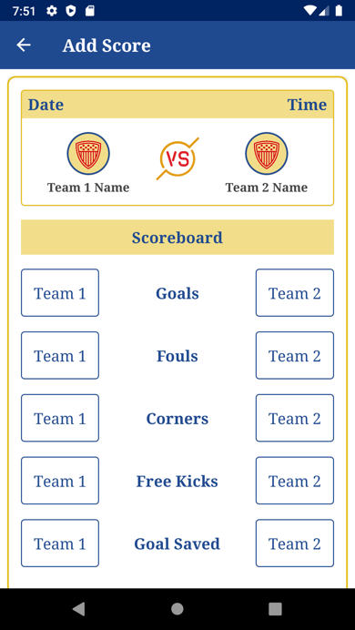
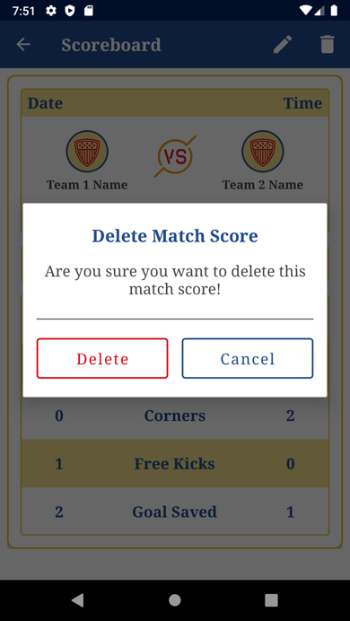

Slide 27
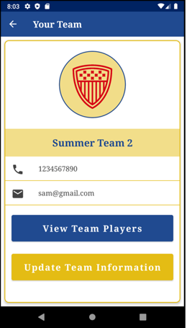
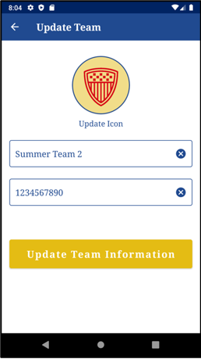
TEAM MANAGER SCREEN FOR TEAM MANAGER

Slide 28
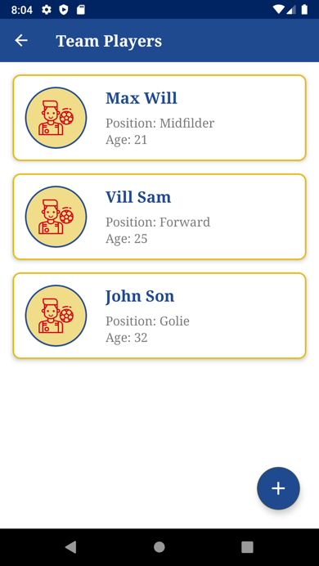
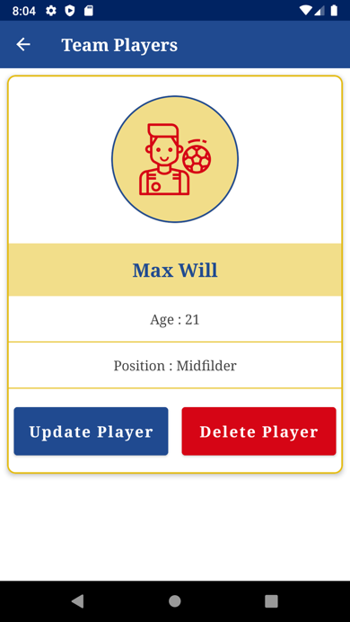
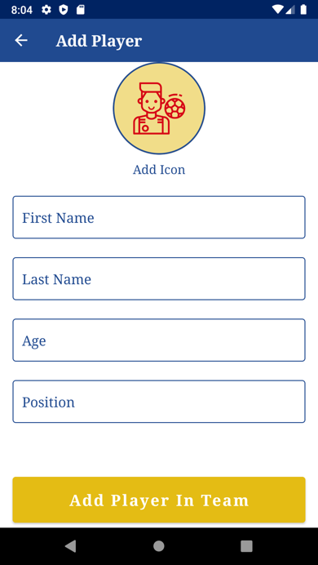
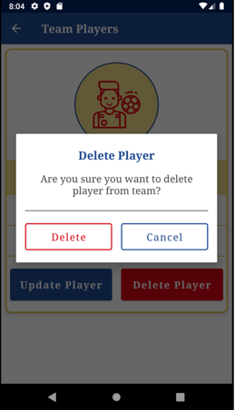
TEAM PLAYERS SCREEN FOR TEAM MANAGER

Slide 29
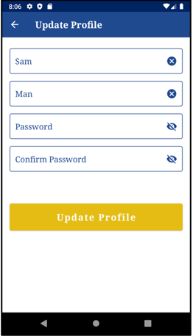
UPDATE PROFILE SCREEN FOR LEAGUE MANAGER AND TEAM MANAGER

Slide 30
Hardest things in our application
Delete league and Team was difficult because to delete it we have to delete all related matches and scores and players as well.
In firebase we have to do it one by one

Slide 31


